Slide 1
Lunar Landing
Reinforcement learning
Soh Hong Yu & Samuel Tay Tze Ming
P2100775 & P2107404
DAAA/FT/2B/01

Slide 2

EDA
Action 1 (Do Nothing)
Action 2 (Left Engine Fire)
Action 3 (Main Engine Fire)
Action 4 (Right Engine Fire)

Slide 3
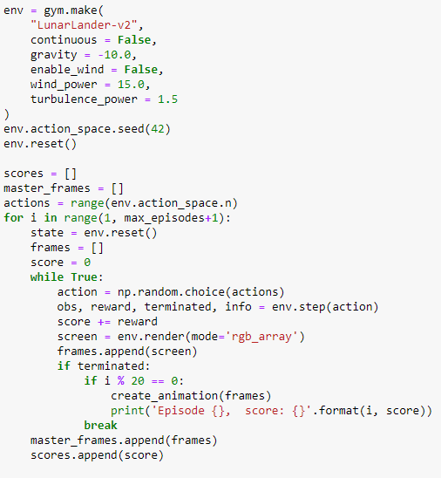
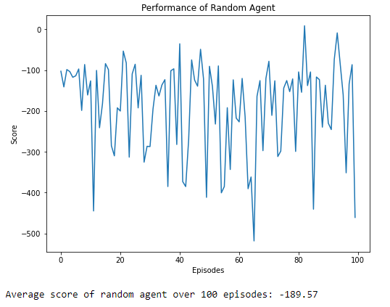
Random action model

Slide 4
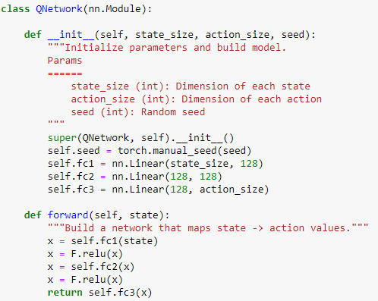
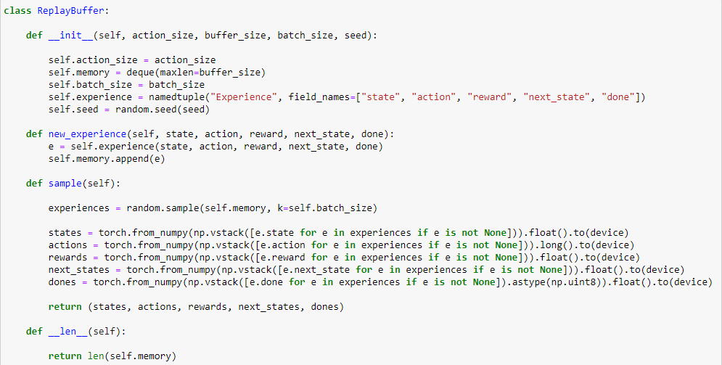
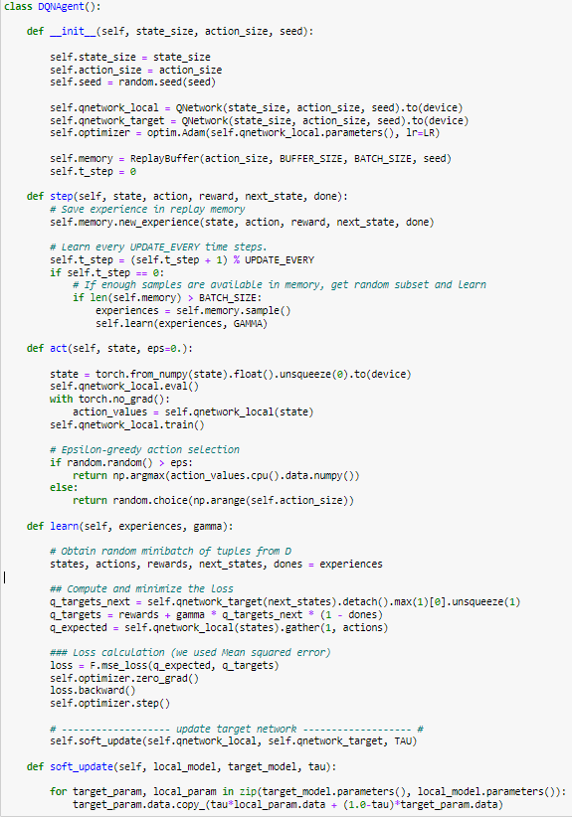
DQN
Policy
Replay Buffer
Agent
Deep Q-Network is a reinforcement learning algorithm that uses a deep neural network to approximate the Q-value function, allowing the agent to learn from our environment. The goal of DQN is to find the optimal policy that maximizes the reward over time. The algorithm updates the network parameters by minimizing the difference between the predicted Q-values and the target Q-values, and uses experience replay and fixed Q-targets to improve stability and convergence.

Slide 5
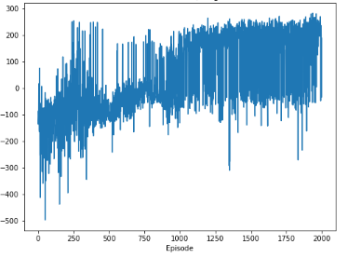
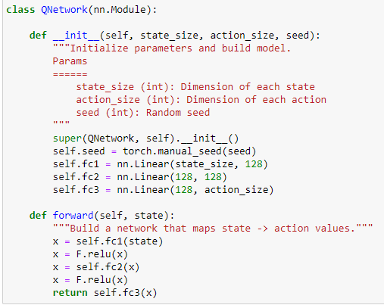
DQN
Performance of DQN Model 1
DQN Base model
Average Model Score: 180
Best Model Score: 253

Slide 6
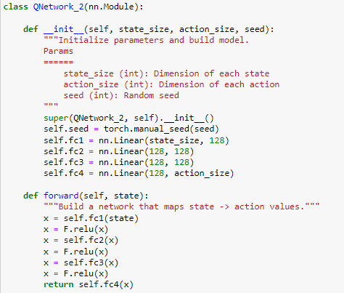
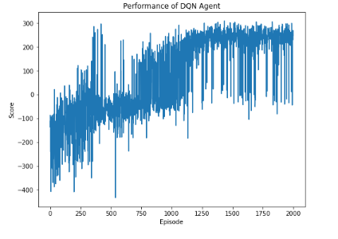
Improved DQN
Improved Q Network
Performance of Improved DQN Agent
Average Model Score: 220
Added an extra layer
Best Model Score: 282

Slide 7
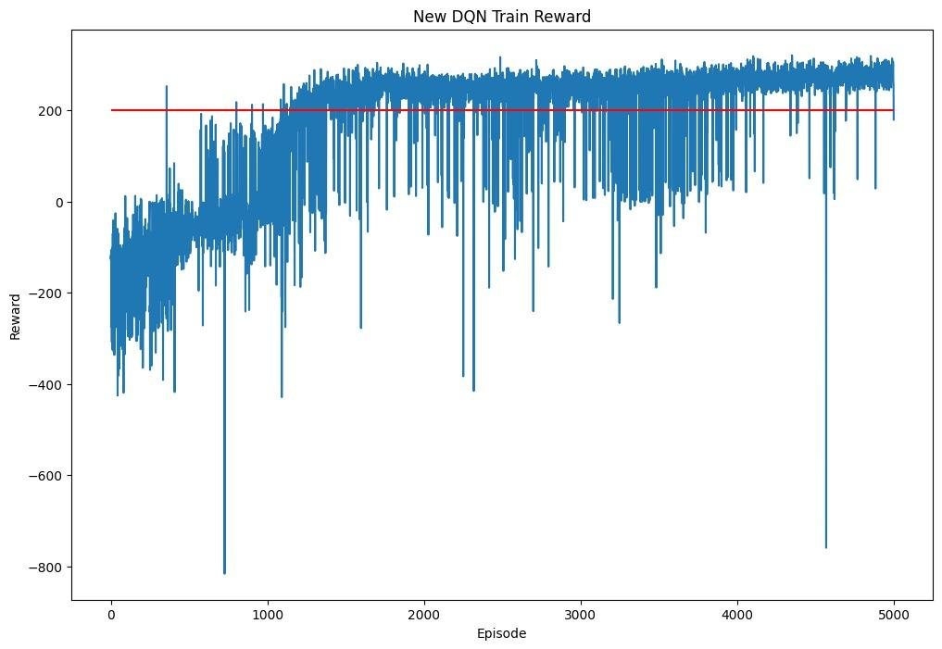
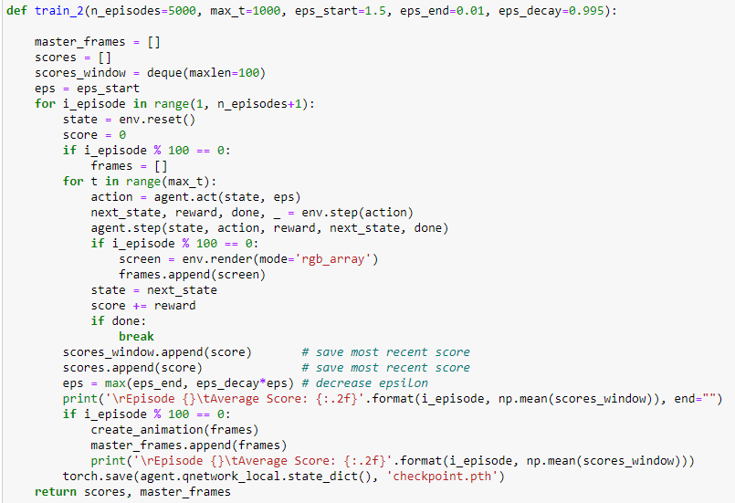
Hyperparameter dqn
Performance of hypertuned DQN Agent
Changed epsilon 1.0 to 1.5
Average Model Score: 250
Best Model Score: 301.2873092834319

Slide 8
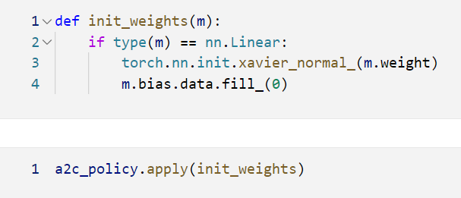
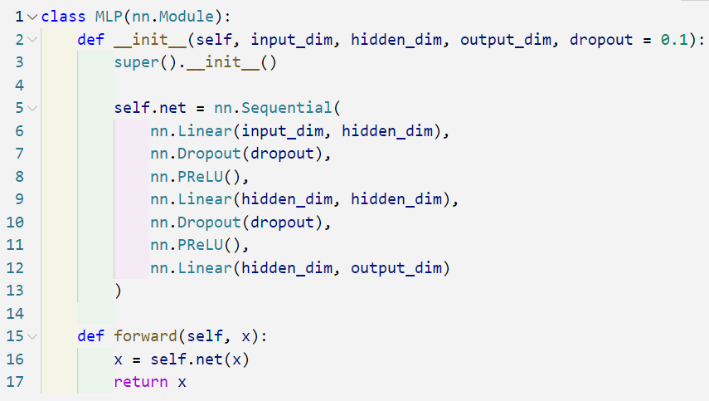
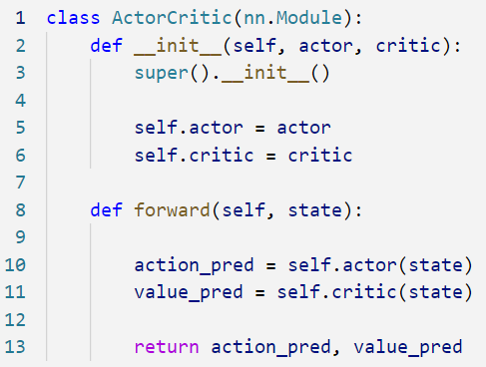
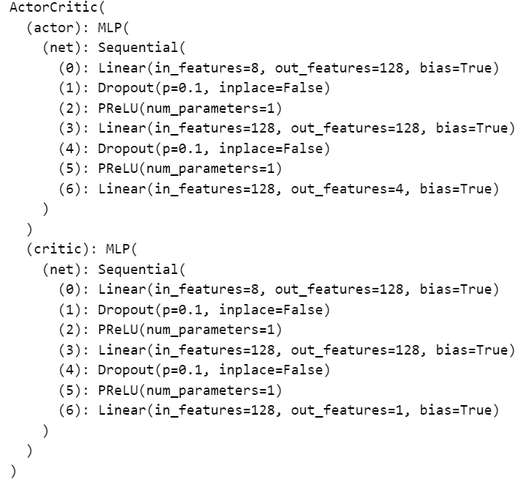
Advantage Actor Critic (A2C)
Advantage Actor Critic (A2C) is a policy-based algorithm that has been used with success on a number of challenging tasks. It combines the Policy Based RL [DQN] and Value Based RL.
Weight Initialiser
Multi Layer Perceptron
Agent
Model Architecture

Slide 9
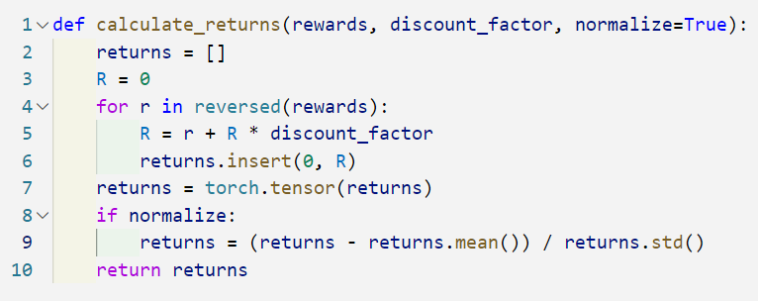
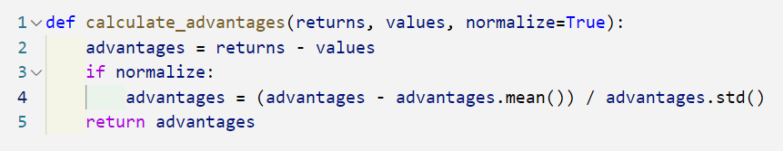
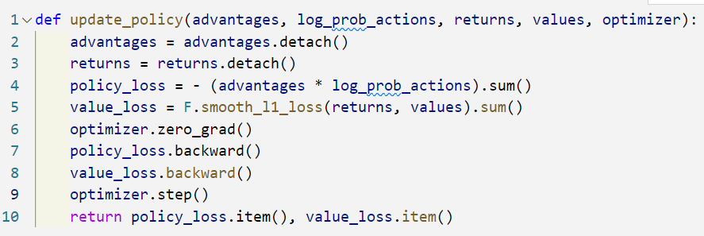
Advantage Actor Critic (A2C)
As A2C uses both values and policies as the computational cost, we will need to update both the actor and critic

Slide 10
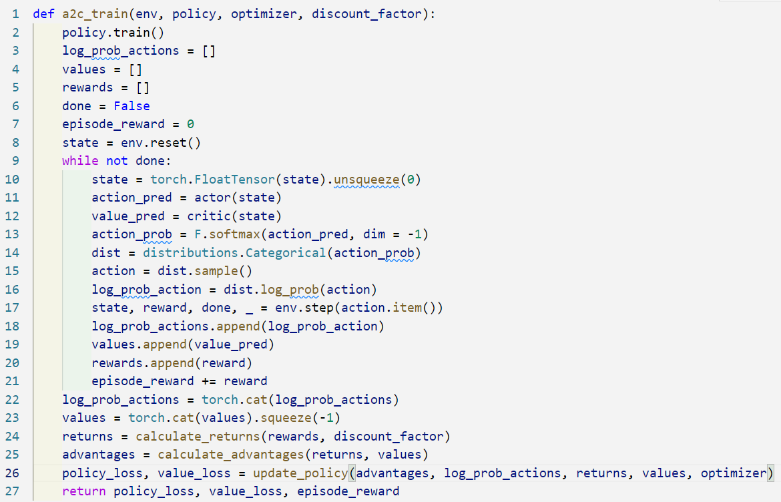
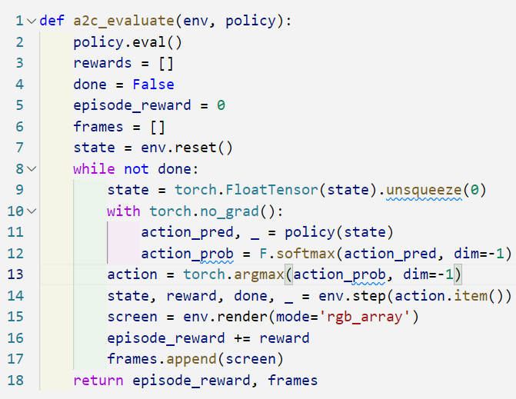
Advantage Actor Critic (A2C)
Train
Evaluate

Slide 11
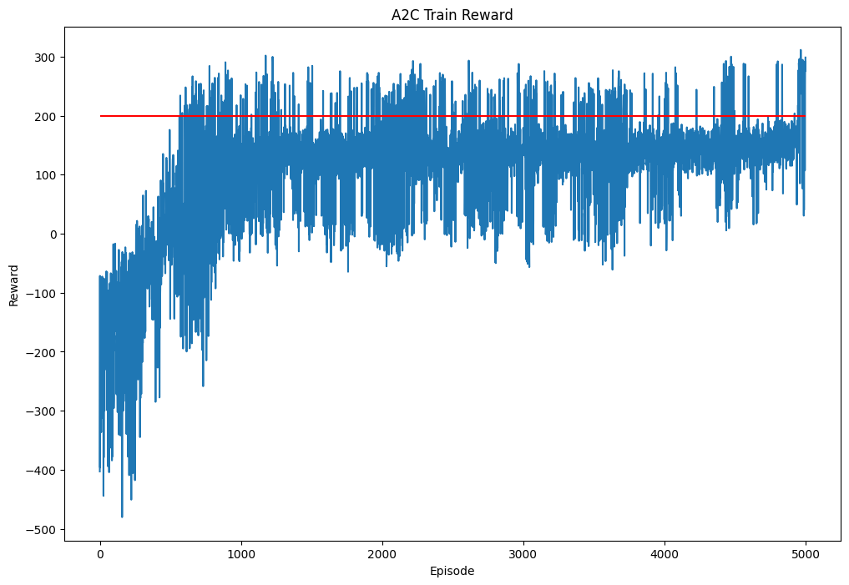
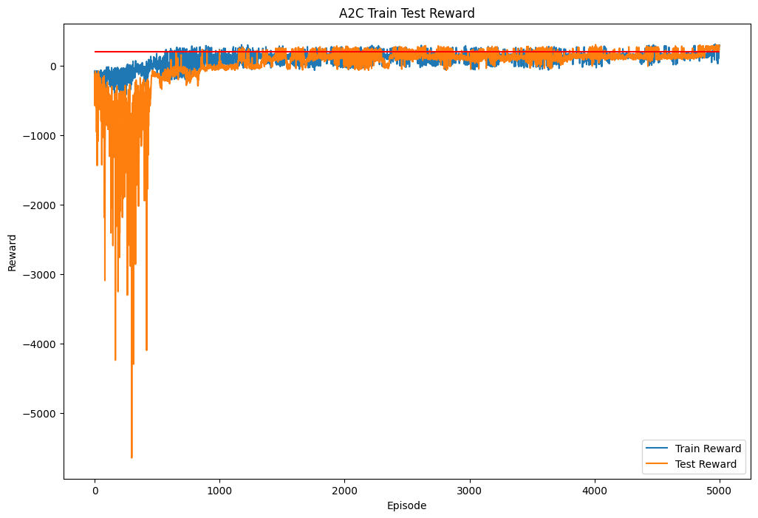
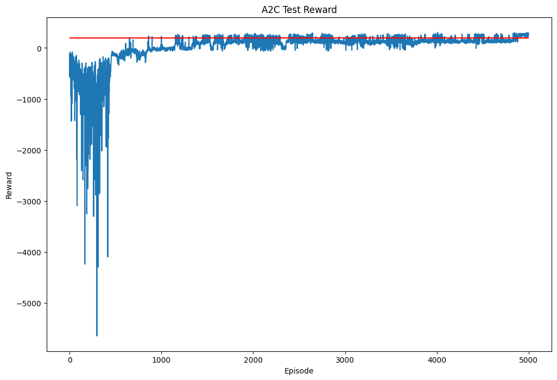

Advantage Actor Critic (A2C)
Performance of A2C Model

Slide 12
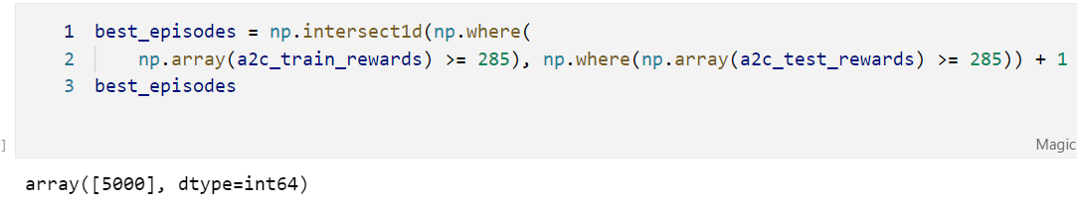
Advantage Actor Critic (A2C)
We will be choosing the values where both training and testing rewards are the higher than the reward threshold. Train >= 285 and Test >= 285
We see that model A2C was able to land the lunar lander safely without crashing and using the least fuel to get the job done so that it can score a high score.
Model Score: 307.0810140291526

Slide 13
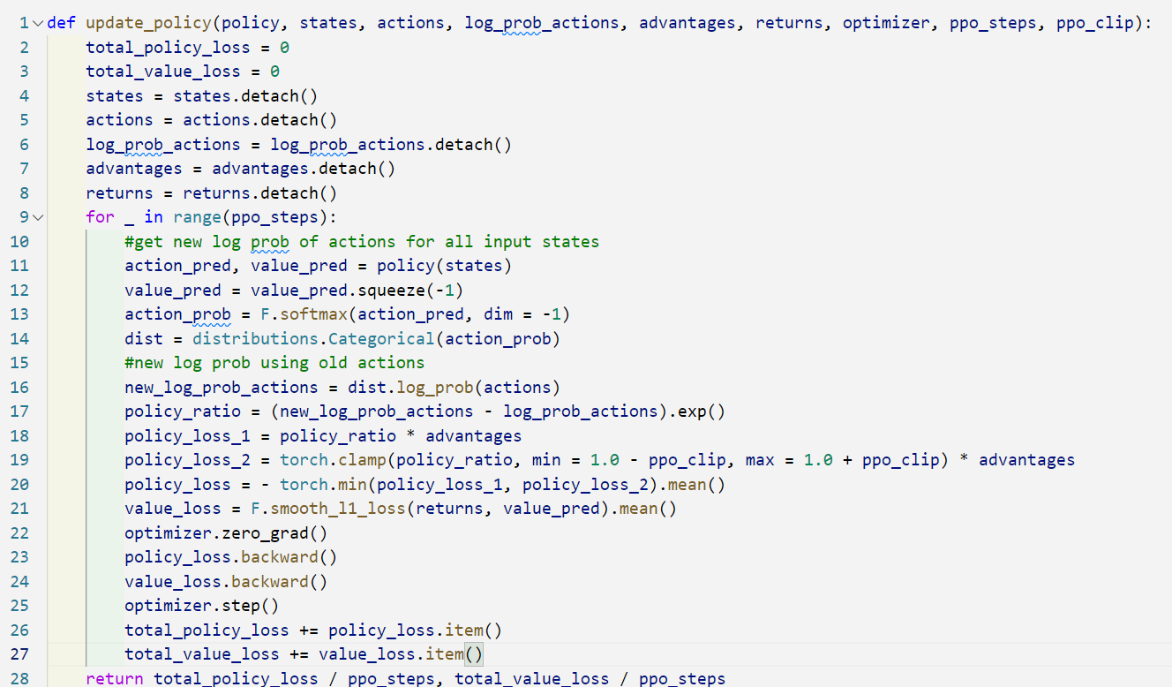

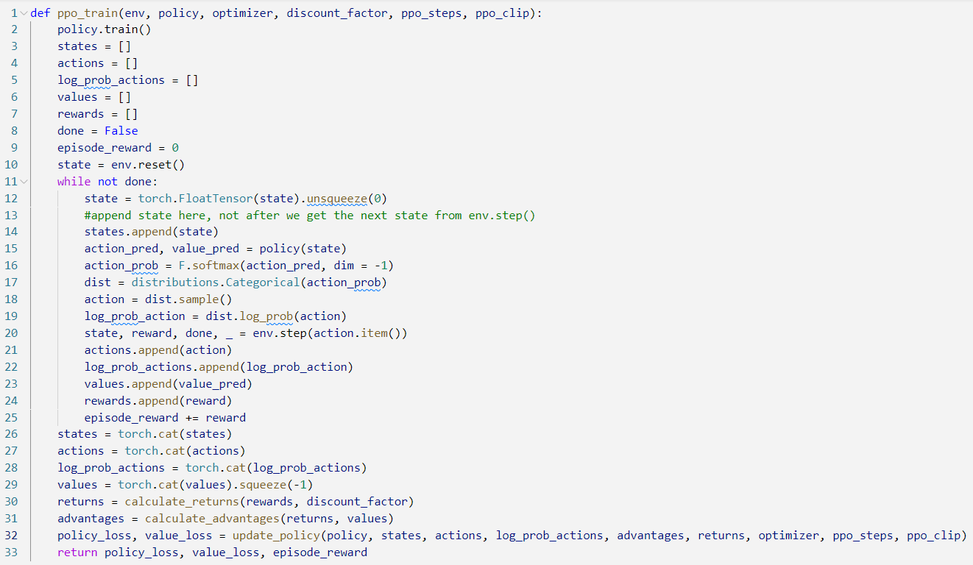
Proximal Policy Optimization (PPO)
An improvement from A2C where the core improvement is changing on how it estimates the policy gradients. The PPO method uses the ratio between the new and the old policy scaled by the advantages instead of using the logarithm of the new policy:

Slide 14
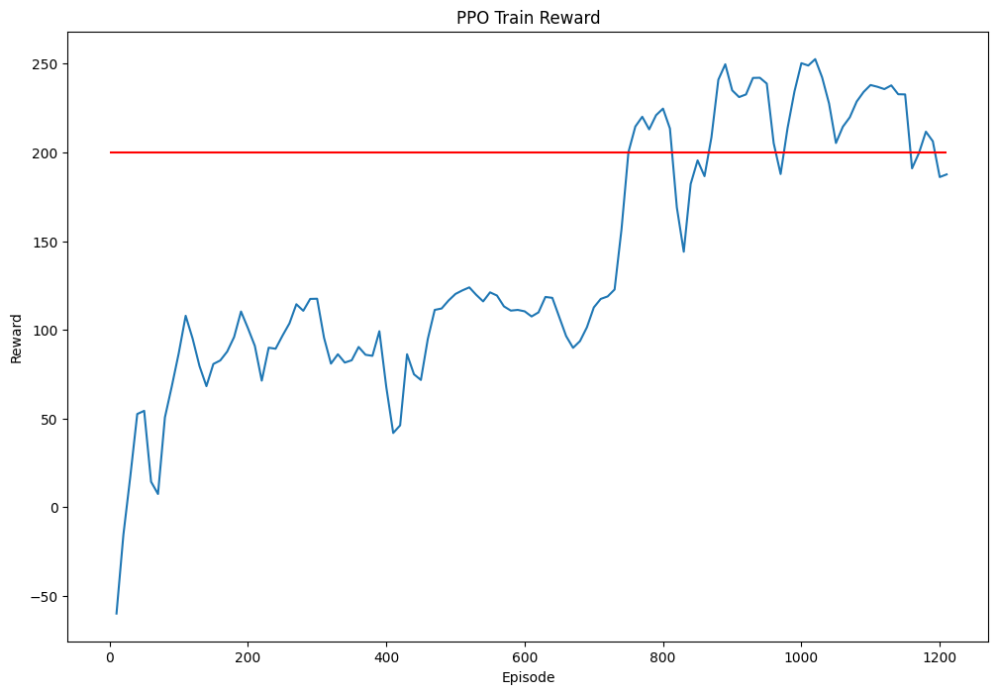
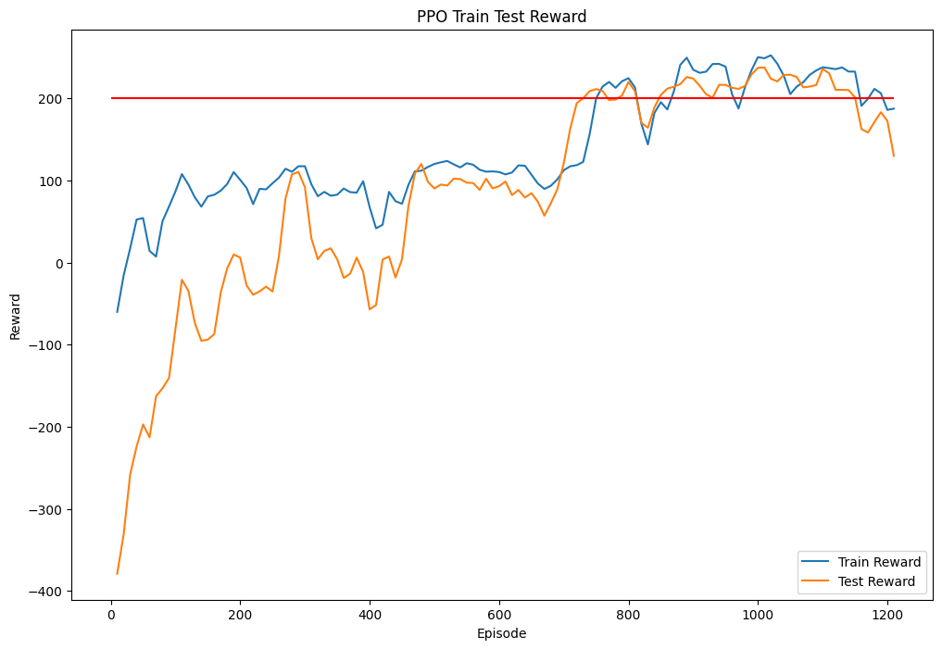
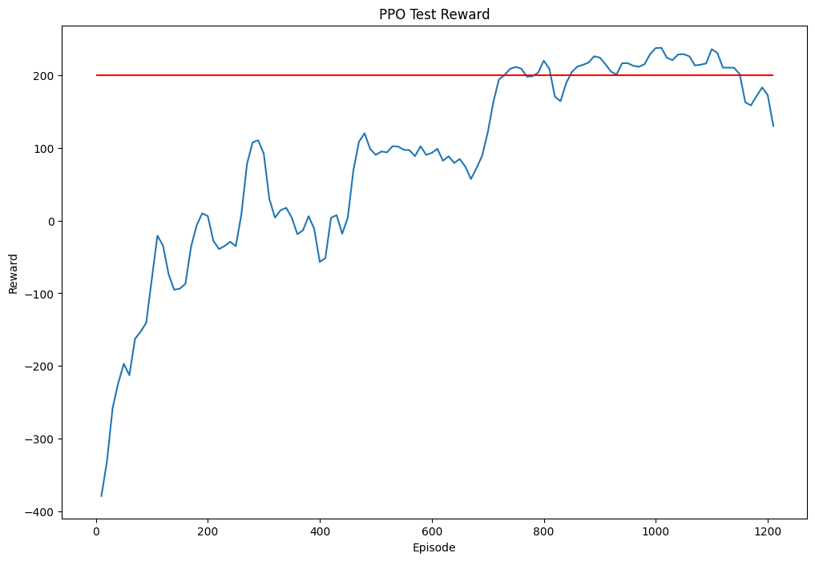

Proximal Policy Optimization (PPO)
Due to time constraint and resources constraint, we are unable to complete the training of PPO to the episode we wanted.

Slide 15
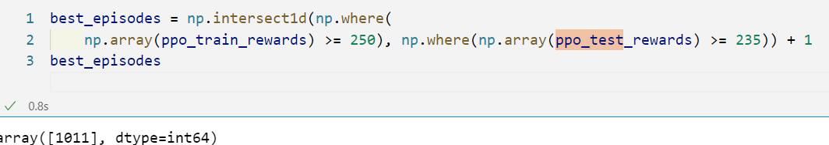
Proximal Policy Optimization (PPO)
We will be choosing the values where both training and testing rewards are the higher than the reward threshold. Train >= 250 and Test >= 235
We see that model A2C was able to land the lunar lander safely without crashing and but as the model was not fully trained and optimized, the model used a lot of fuel which resulted in the low model score.
Model Score: 258.4892892114275

Slide 16
SUmmary
A2C is a better model compared to DQN because it separates the learning of the policy and the value function into two separate neural networks. This allows the algorithm to directly optimize the policy by maximizing the expected cumulative reward, rather than estimating the Q-value function as in DQN. This can result in a more efficient learning process and a better exploration-exploitation trade-off.
Another advantage of A2C is that it can handle continuous action spaces, whereas DQN is limited to discrete action spaces. In addition, A2C can handle both on-policy and off-policy learning, while DQN is mainly used for off-policy learning.
However, it should be noted that DQN can still perform well in some problems and is generally easier to implement and understand compared to A2C.
Therefore our final model in this case will be A2C as it has the best performance

